Slide 1

Borsa Italian Listion 2023 - 2024
information from the borsaitaliana.it website to support a publication

Slide 2
Introduction
This analysis focuses on Borsa Italian stocks, examining market distribution, industry segmentation, financial data availability, and COVID study participation from year 2023-07-11 to 2024-02-23.
Dataset Overview:
593 rows, 16 columns
Includes stock details, market, industry, financial accounts, and COVID study status.
Souse of the data - https://www.kaggle.com/datasets/robertolofaro/borsa-italiana-listino-as-of-20221119.

Slide 3
Dataset Overview
593 stocks, 16 columns.
Key columns:
Stock Name, Market, Industry, ISIN, Financial Data.
COVID Study Participation, Yahoo Finance Links.
Data Cleaning Process:
Replaced missing values.
Converted categorical variables for analysis.
Removed inconsistencies.

Slide 4
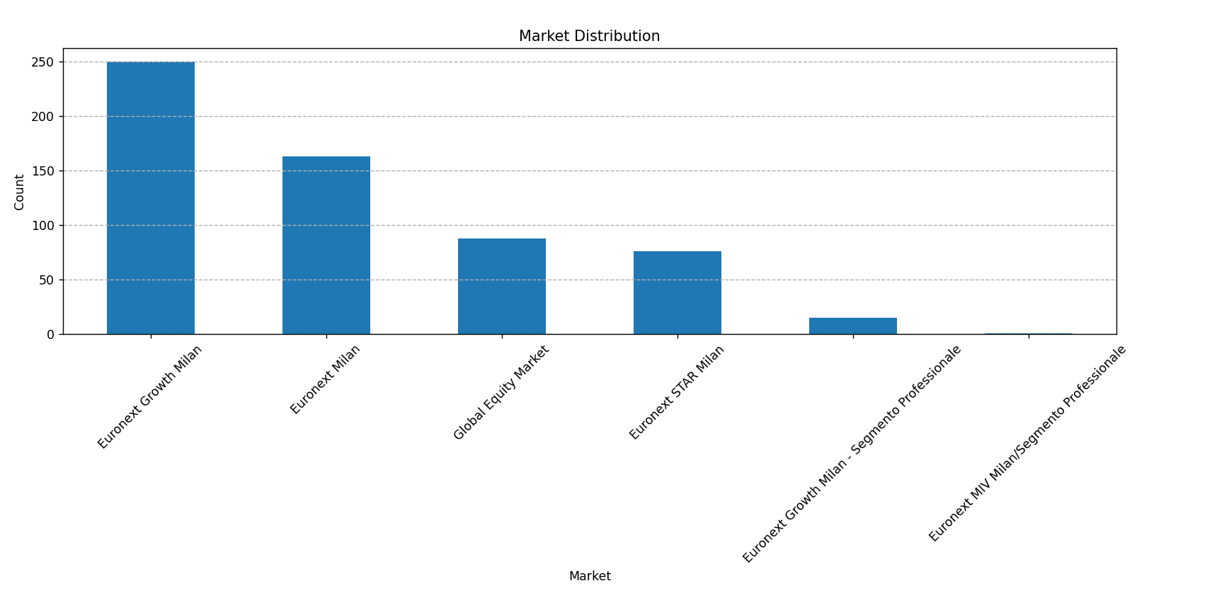
Market Distribution
Euronext Growth Milan dominates with 250 stocks.
Euronext Milan follows with 163 stocks.
Other markets include Global Equity Market, STAR Milan, etc.
Growth markets indicate strong SME presence

Slide 5
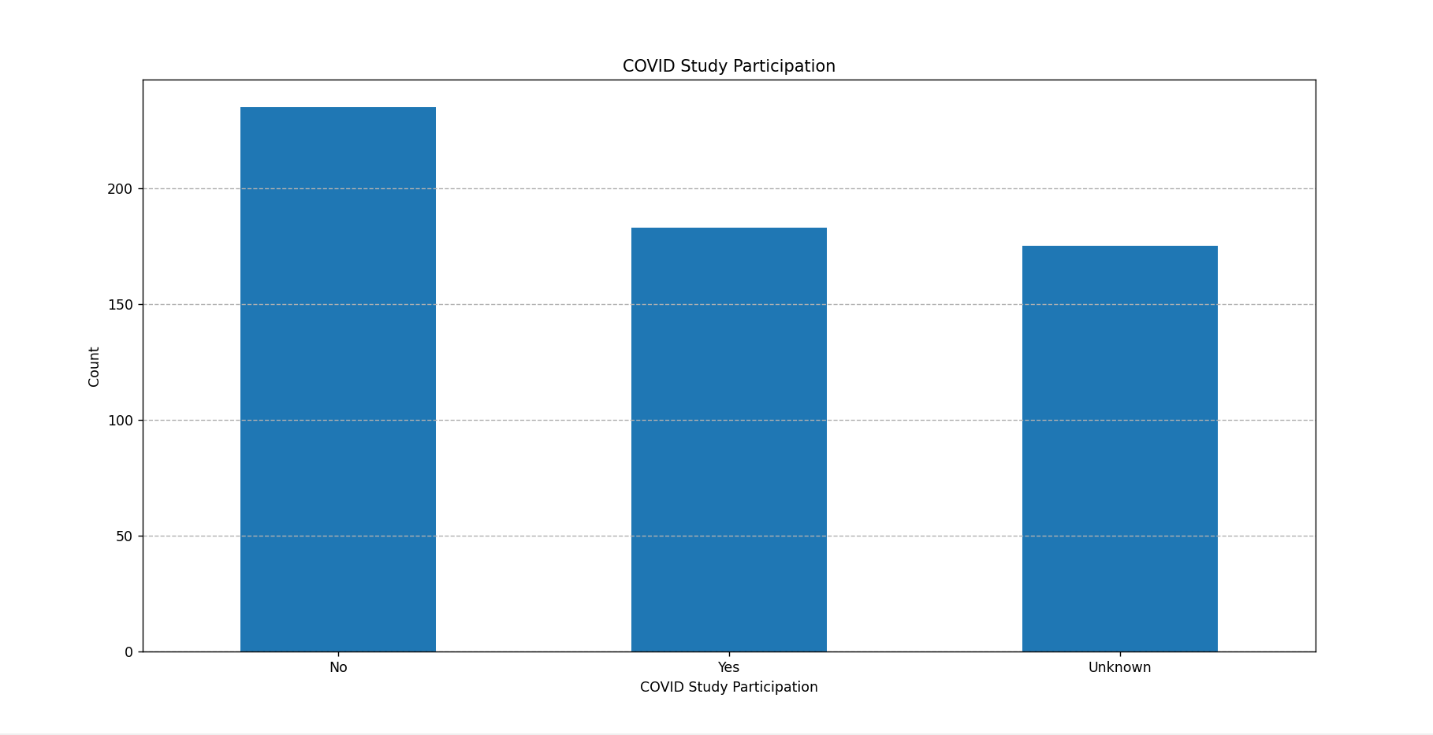
COVID Study Participation
235 companies participated.
183 companies did not participate.
175 have unknown status.
Implications:
Certain industries may have been more impacted by COVID.
Data gaps could affect financial forecasting.

Slide 6
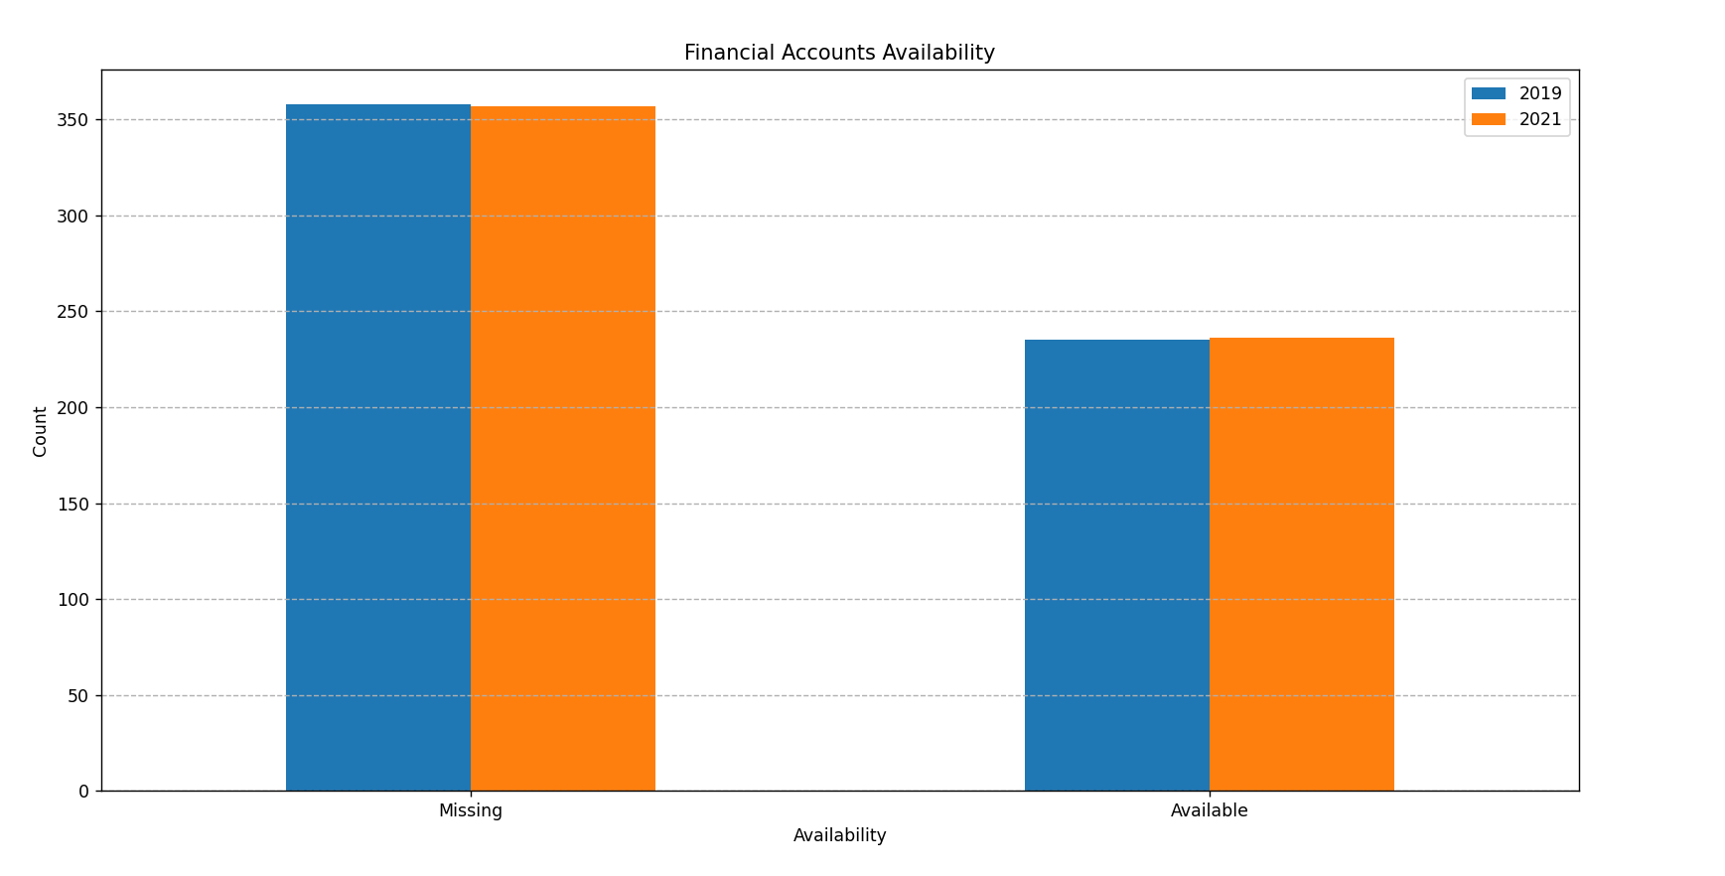
Financial Accounts Availability
235 companies have financial data for 2019.
236 companies have financial data for 2021.
Many companies lack full financial records.
Missing data makes valuation and investment riskier.

Slide 7
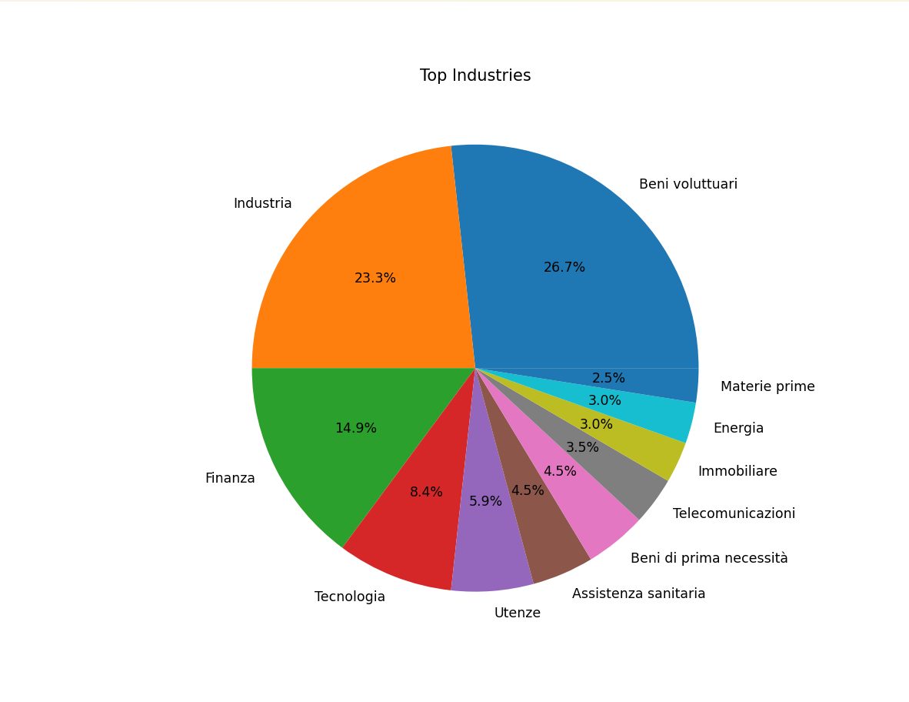
Industry Distribution
Top industries by stock count:
Consumer Discretionary (Beni Voluttuari): 26.7%
Industrials: 23.3%
Finance: 14.9%
Technology: 8.4%
Tech and Finance are emerging but not dominant.
Consumer goods & industrials still lead.

Slide 8
Market vs Industry Cross-Tabulation
Key Insights:
Euronext Milan has stocks in multiple industries.
Technology companies are mainly in STAR & Growth markets.
Healthcare stocks favor professional markets.
Helps investors identify sectoral concentration.

Slide 9
Conclusion
Market Trends: Euronext Growth Milan leads, SMEs dominate.
Industry Insights: Consumer goods & industrial sectors are strongest, while tech & healthcare are emerging.
Financial Data Gaps: Many companies lack full-year reports, affecting transparency.
COVID-19 Impact: Study participation varies; long-term effects require further analysis.
Investment Strategy: Focus on industries with stable reporting and growth potential.

Slide 10
Recommendations & Next Steps
Further analysis on stock performance over time.
Identifying growth trends in emerging industries.
Improving financial data reporting for better insights.
Exploring global market comparisons for better benchmarking.

